Slide 1
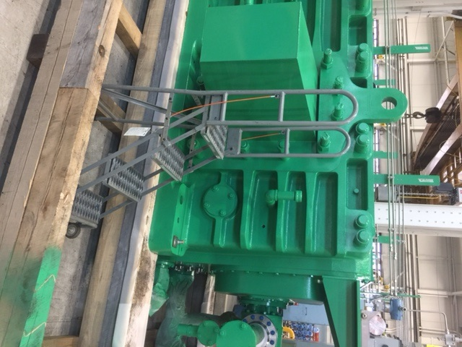

HS&E INCIDENT BULLETIN |  | 1st half year 2017
Painted Post, New York | Type of incident (Shoulder Strain – Slip, Trip and Fall)
Summary:
An employee was working on a unit in Shop 22 Assembly. The employee stepped off the frame onto a step ladder and lost his balance, falling against the skid. As a result, he dislocated his left shoulder. The Emergency Response Team was notified and treated the employee on site. The employee was then transported to the hospital for further evaluation and treatment.
Root Causes: | Actions Taken Thus Far: Next Steps
Multi-level work areas present a risk of falling. The work area was congested. Lack of situational awareness. | A plant-wide Stand-Down was held to communicate the incident. Open area around skid was covered with a platform. Future skids with similar hazards to be built with platforms from supplier. Process flow/area designation implementation project (with department and Process Innovation group) is currently underway. Risk assessment (HIRA) was reviewed and revised to reflect more control measures.
Where employee was working
Point of impact

